Slide 1
Parking Assistance System using Slot-based Driving
Pulkit Agarwal
Date 15/04/2021

Slide 2
Overview
Project Background
Related Works & Applications
Proposed Solution
Design & Architecture
Implementation Issues
Project Demonstration
Evaluation
Conclusions

Slide 3
Project Background
Large scale events, that include mass participation of the public such as musical concerts, sporting events, or even shopping centers during holidays and festivals often result in traffic congestion at the venue and even surrounding areas.
One of the main reasons for this problem is inefficient parking guidance i.e., vehicle owners not being aware of the available parking slots, or if aware, not being able to optimally reach the parking location.
Our hypothesis for the project states that this poor co-ordination between vehicles and the global situation could be improved if the actions of these vehicles were coordinated individually with proper knowledge and guidance.
We plan to resolve this widespread problem using Simulation for Urban Mobility (SUMO) which is a road transport simulation software and using the software to test our proposed hypothesis with the traffic congestion in parking areas and hopefully achieve a better traffic flow rate.

Slide 4
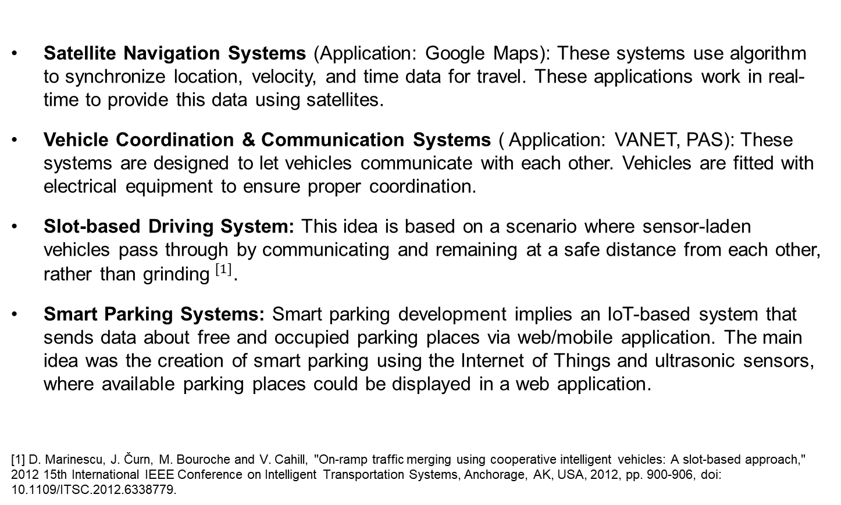
Related Works & Applications
Satellite Navigation Systems (Application: Google Maps): These systems use algorithm to synchronize location, velocity, and time data for travel. These applications work in real-time to provide this data using satellites.
Vehicle Coordination & Communication Systems ( Application: VANET, PAS): These systems are designed to let vehicles communicate with each other. Vehicles are fitted with electrical equipment to ensure proper coordination.
Slot-based Driving System: This idea is based on a scenario where sensor-laden vehicles pass through by communicating and remaining at a safe distance from each other, rather than grinding$^{[1]}$.
Smart Parking Systems: Smart parking development implies an IoT-based system that sends data about free and occupied parking places via web/mobile application. The main idea was the creation of smart parking using the Internet of Things and ultrasonic sensors, where available parking places could be displayed in a web application.
[1] D. Marinescu, J. Čurn, M. Bouroche and V. Cahill, "On-ramp traffic merging using cooperative intelligent vehicles: A slot-based approach," 2012 15th International IEEE Conference on Intelligent Transportation Systems, Anchorage, AK, USA, 2012, pp. 900-906, doi: 10.1109/ITSC.2012.6338779.

Slide 5
Proposed Solution
Our solution for our project was to implement an efficient parking assistance system with optimal and guided driving. We tend to provide this advice to the drivers based on a model of vehicle co-ordination that we term as “Slot-Based Driving”.
This above-described approach is like the Time-Division Multiple Access (TDMA) Method used in Data Communication Systems to allocate slots to packets of messages in transit.
This method will not only allow us to design a route for the vehicles in transit by defining their source and destination location but also optimizing the traffic congestion within the parking area and obtaining a better flow rate for the traffic by prioritizing none and all the vehicles at the same time.
We also designed a cross-platform mobile application to provide vehicle drivers approaching or leaving a parking area with this information to make the system more responsive.

Slide 6
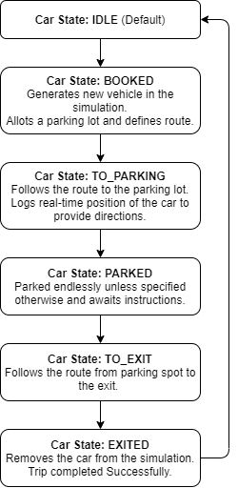
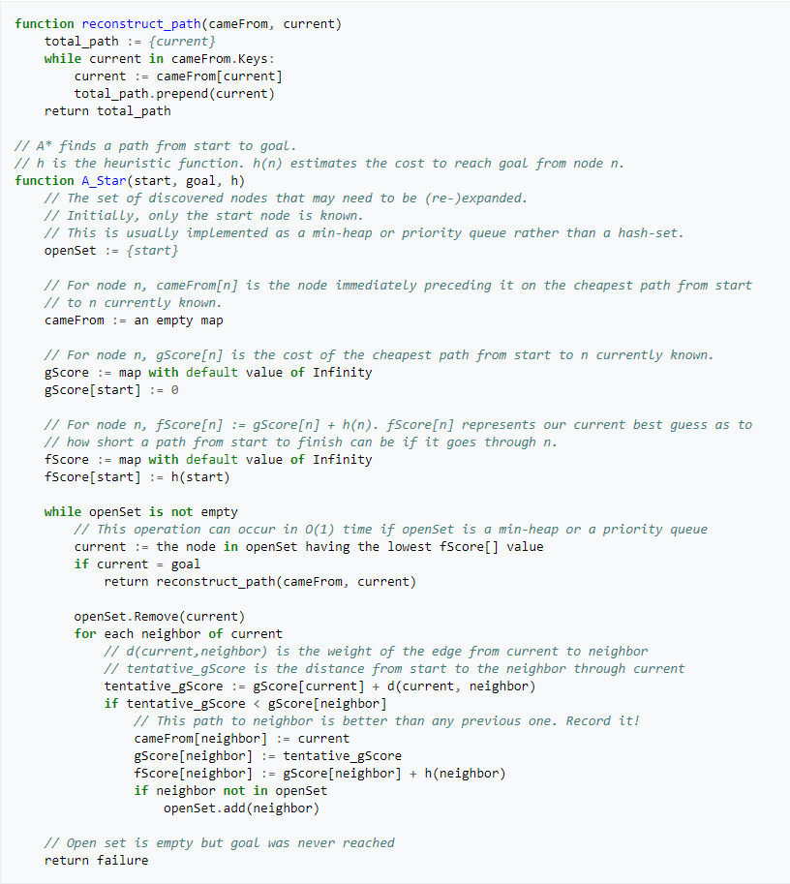
Design & Architecture (Simulation)
The software is designed to use the A* Algorithm to compute the shortest distance
between nodes using graph traversal as compared to the most commonly used
Dijkstra Algorithm. This is because this technique uses graph traversal technique to
calculate the cost and provide the most optimal path.

Slide 7
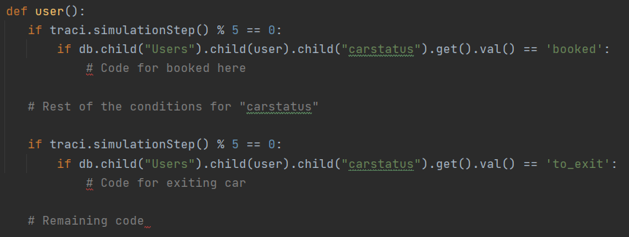
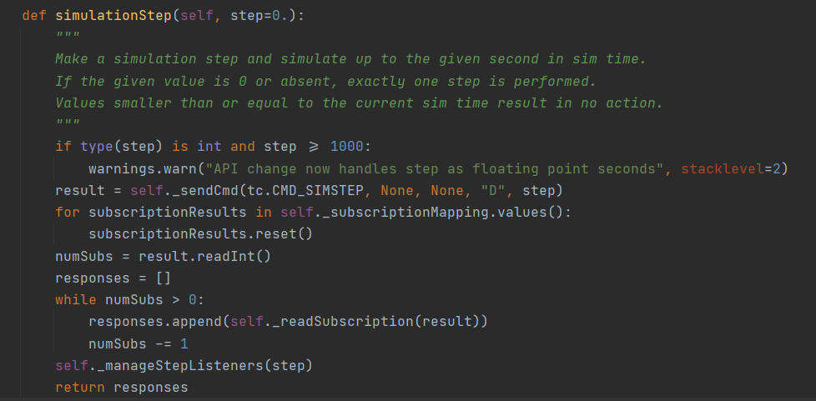
Design & Architecture (Simulation)
Slot-based Driving Technique: Slots are generated every 5 simulation steps. This step length was calculated by determining the safest head-to-head distance between two vehicles. This system works like TDMA in Data Communications with slots being the packets and vehicles their data.
Simulation Step Function: This function is one of the most important functions of the system. It helps provide a reference and basis as to how the program will proceed. The slot-based mechanism for the project derives from here which further controls the entire program and helps run smoothly.

Slide 8
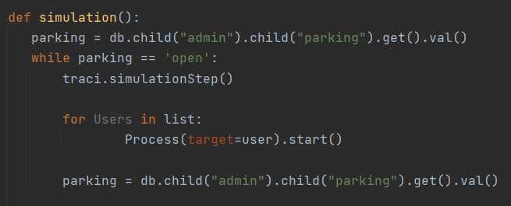
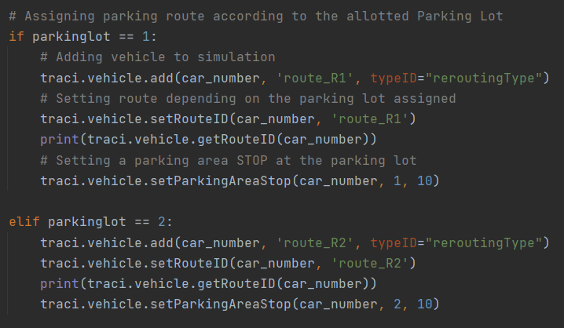
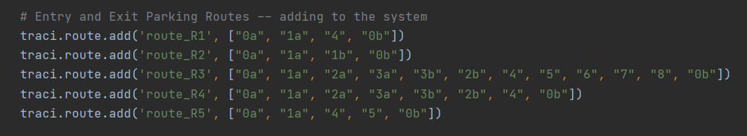
Design & Architecture (Simulation)
Multi-threading: As the program requires many vehicles to run simultaneously, multi-threading allows to run the simulation together for many users.
Lot assignment and Route determination: Routes are pre-defined with starting and ending edges along with the path while reaching the parking lot.

Slide 9
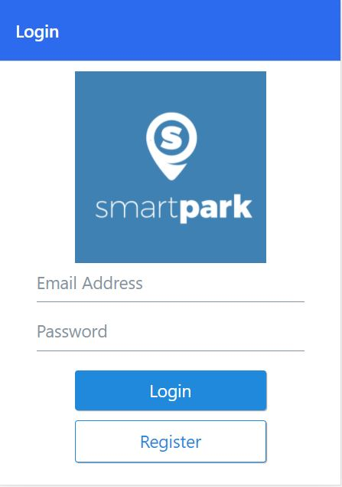
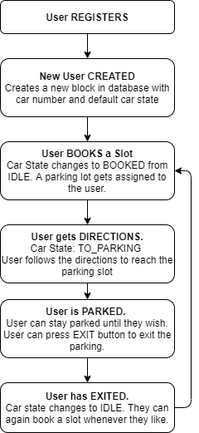
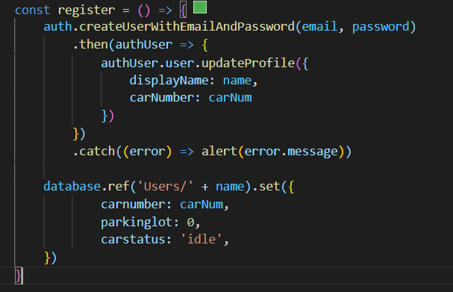
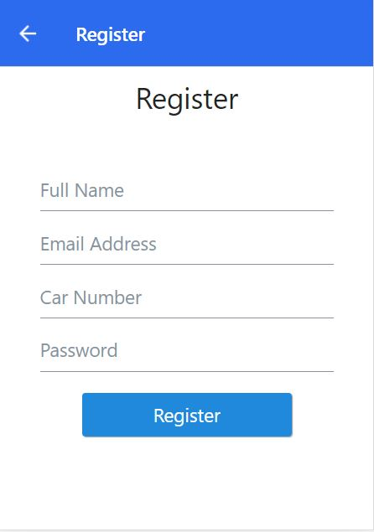
Design & Architecture (Application)
The application aspect of this project is quite simple.
It provides users and interface to register/login into the
system thus creating a block in the database and allowing
them to book a slot and get directions.

Slide 10
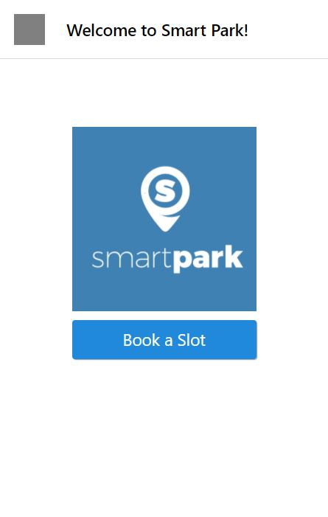
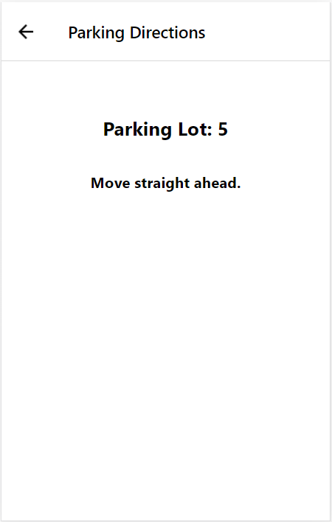
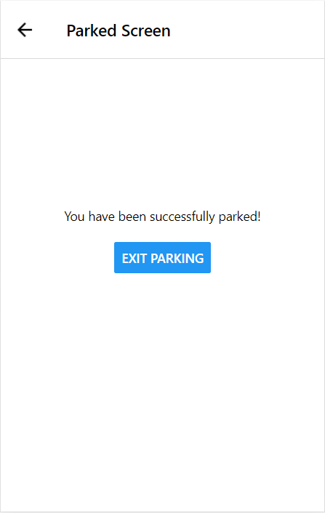
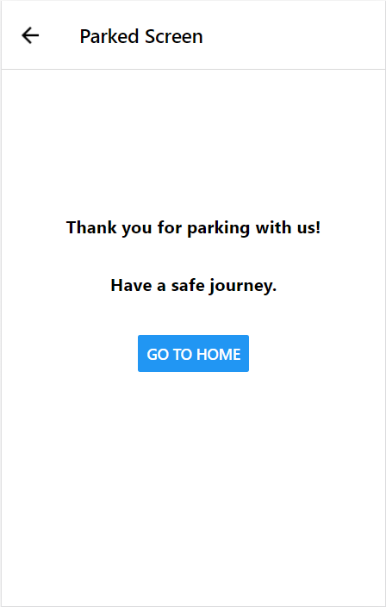
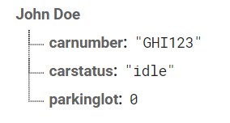
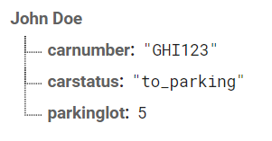
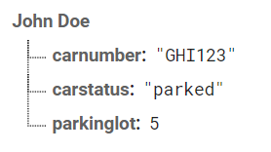
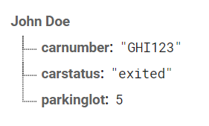
Design & Architecture (Application)

Slide 11
Implementation Issues
Integration with Satellite Navigation Systems
High query response time resulted in slow and delayed simulation
Inability to detect the parked location of the car.

Slide 12
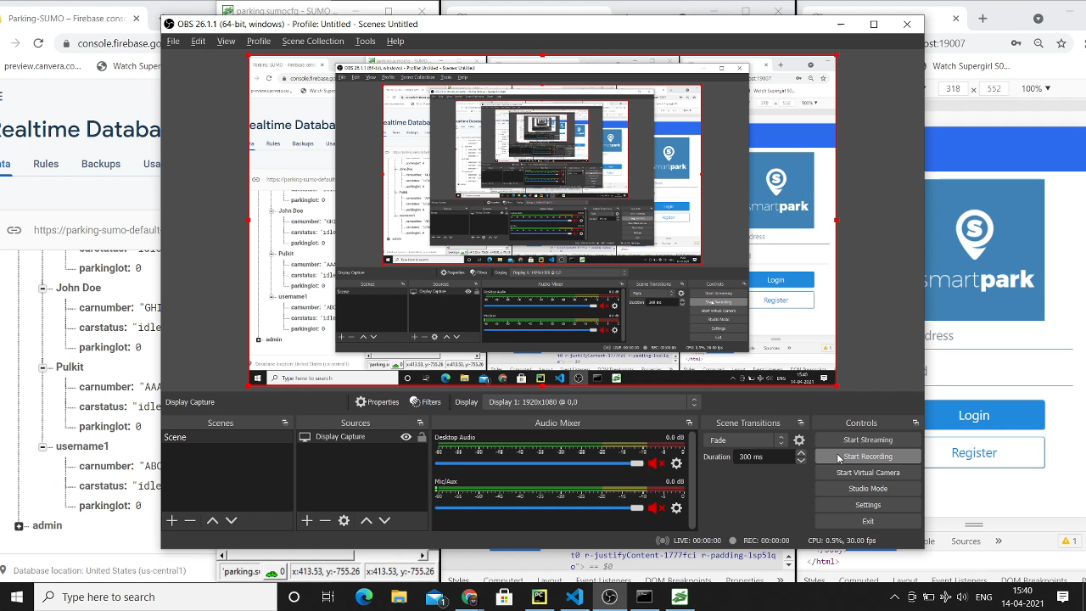
Project Demonstration

Slide 13
Evaluation
Maximum Delay due to Slot-based driving:
1 Simulation Step = 0.25s
1 Slot every 5 Simulation Steps
Therefore, Max. Delay = 1.25s
Pre-defined parking Vs Rerouting:
Rerouting vehicles take more time than pre-defined parking slots.
In this case, time difference is 3.50 seconds.
This time difference solely depends on the speed of the car.

Slide 14
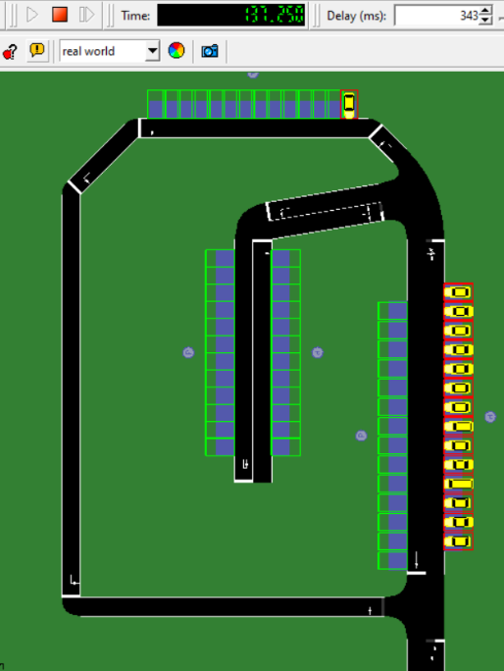
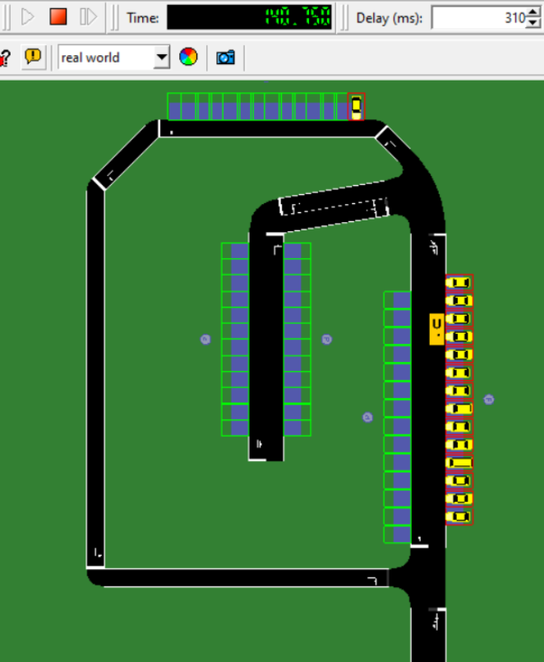
Evaluation
Pre-defined Parking Vehicle Rerouting Parking

Slide 15
Conclusions
Our hypothesis stands strong for the scenario, i.e., having parking information prior and following directions reduces travel time and manages traffic .
One shortcoming of the project is that each parking system needs to be manually designed.
The software requires great processing power and a local database to keep up with the user traffic.
Our approach for the parking assistance system is very basic and simple, yet it displayed an improvement in managing traffic.
The future works would include integrating parking designs to Satellite Navigation Systems and working on a user interface providing real-time position of the users to compare with the cars in the simulation.

Slide 16
Questions ?

Slide 17
Thank You

